Slide 1

Student Management Application
Presented by
===========
Dhanush
Saikiran
Bhavana
Pooja

Slide 2
Index
Requirement Document
Test Plan
Source code(Version 1 and 2)
Console View
Database View
Test Scenario
Test Cases
Defect Log
RTM
Modules
Project Overview

Slide 3
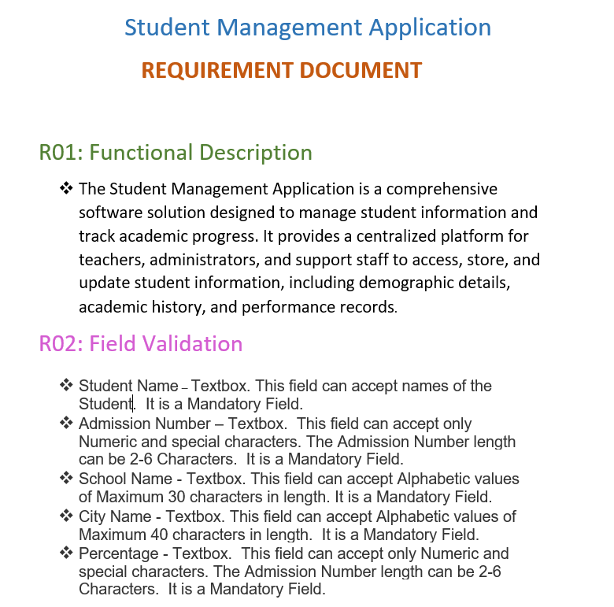
Requirement Document

Slide 4
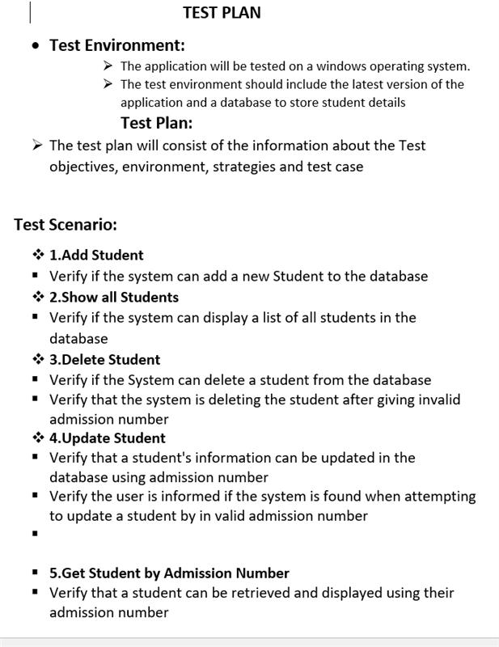
Test Plan

Slide 5
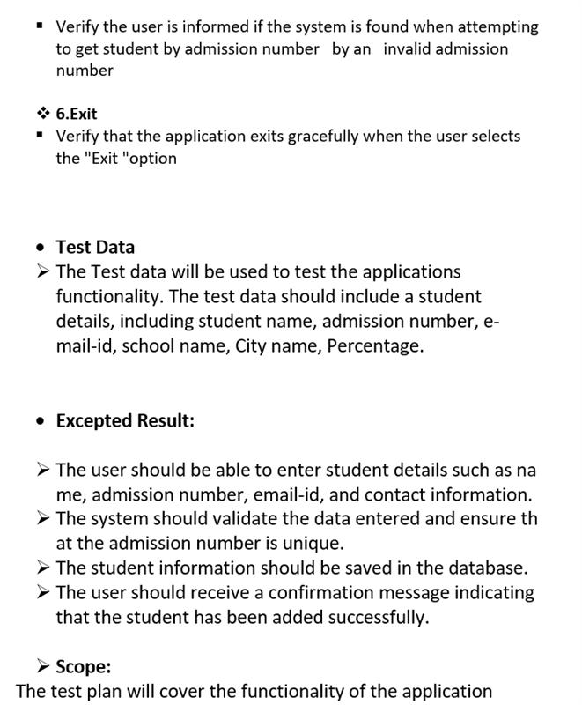
Test Plan

Slide 6
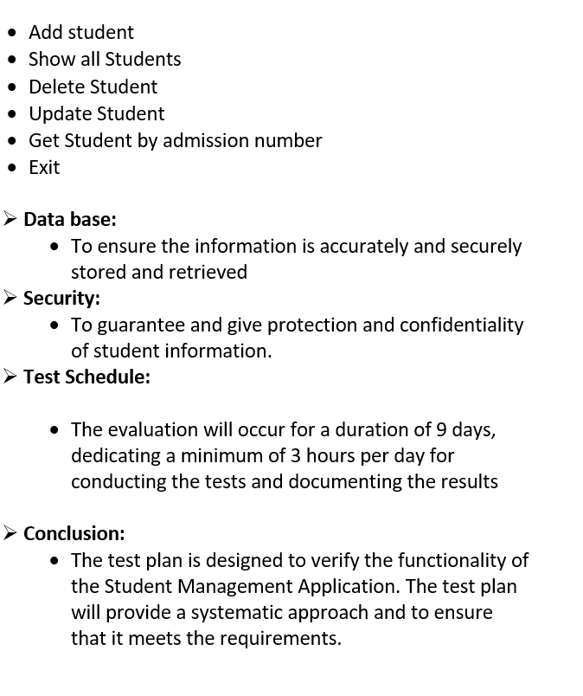
Test Plan

Slide 7
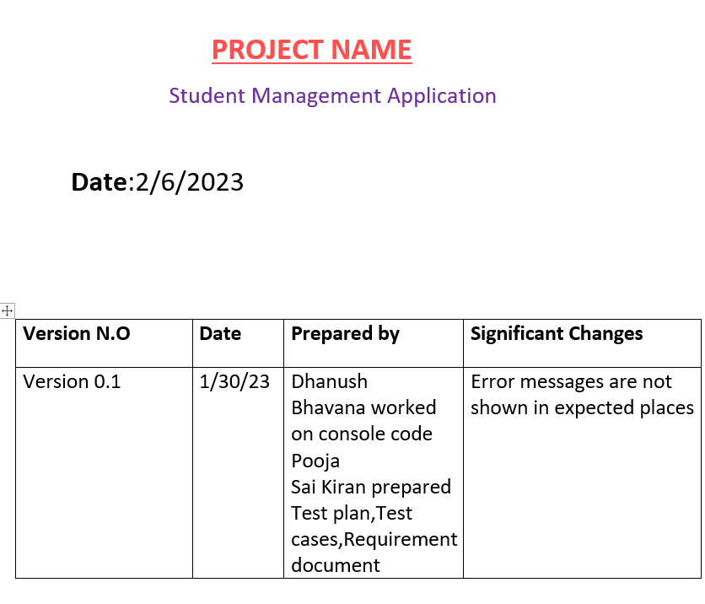
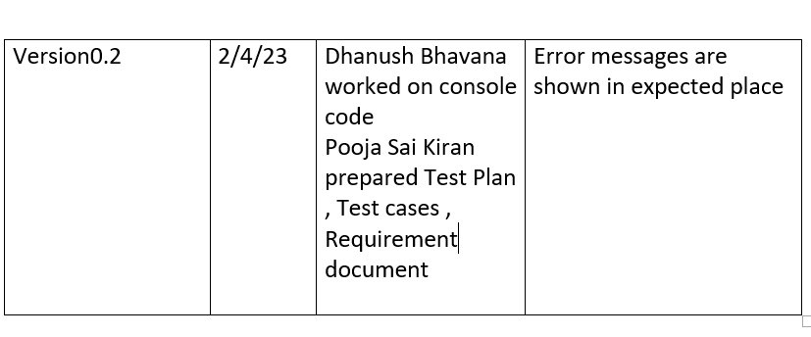
Project Template

Slide 8
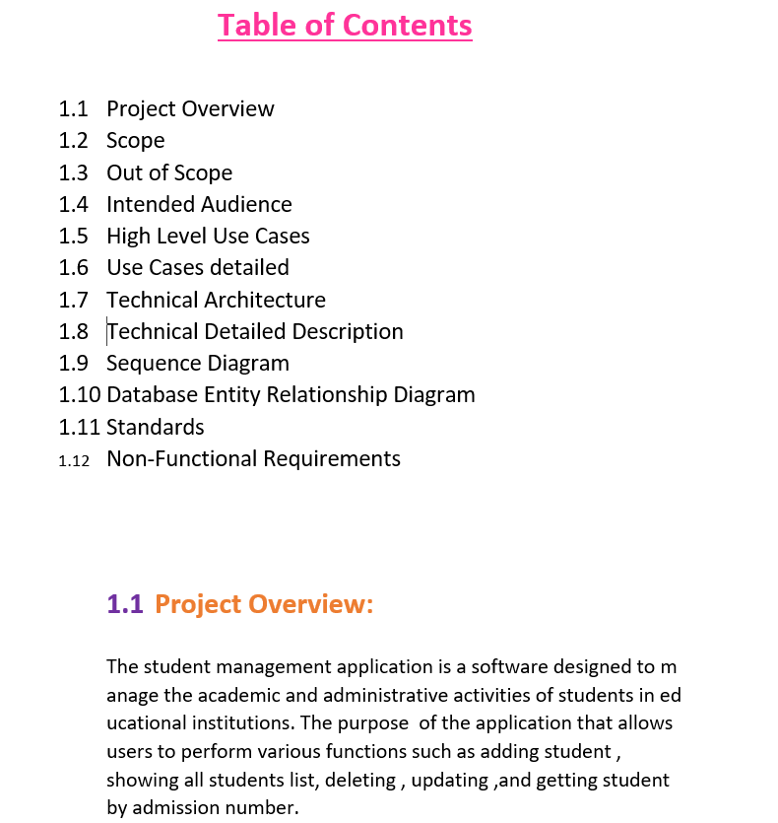
Project Template

Slide 9
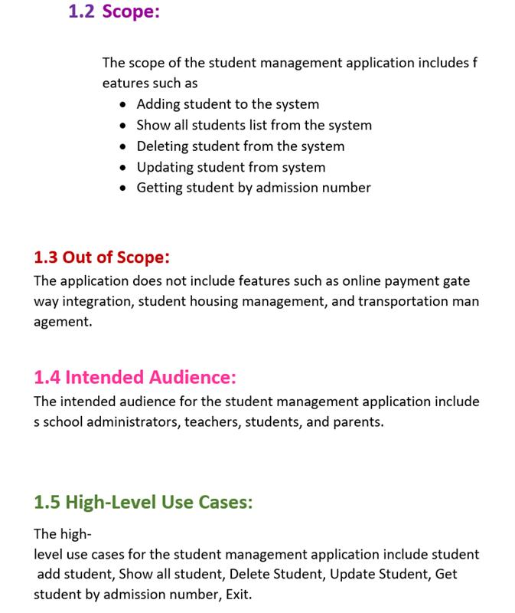
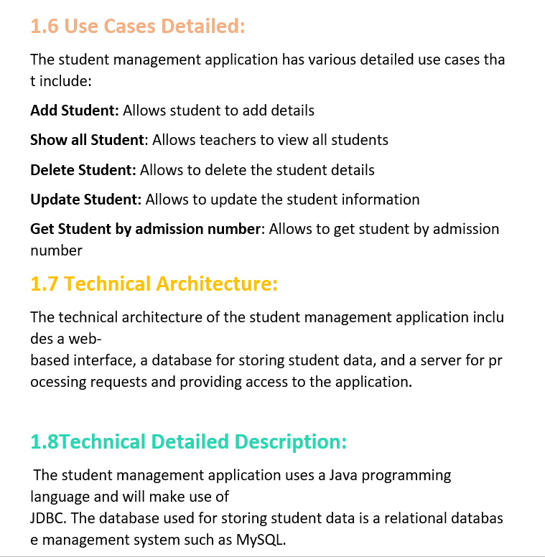
Project Template

Slide 10
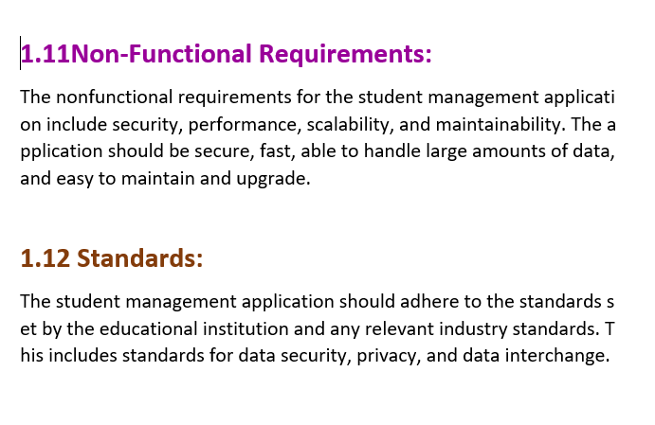
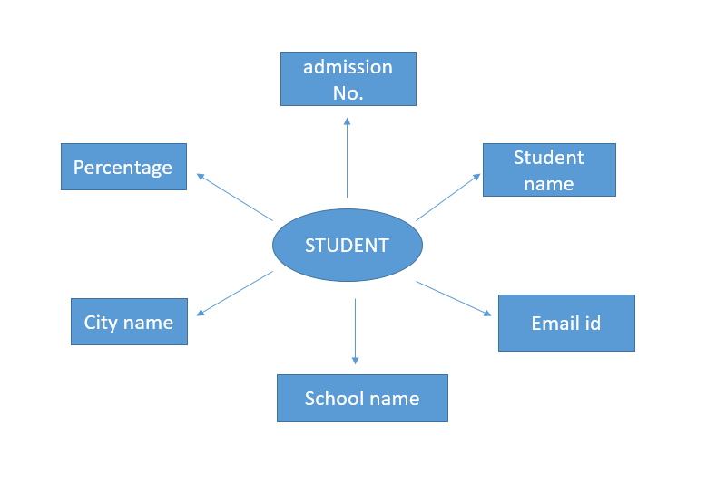
Project Template
Entity Relationship Diagram

Slide 11
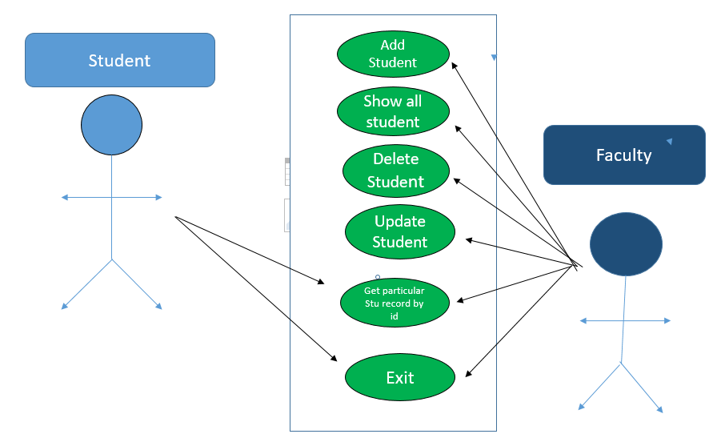
High Level Use Cases

Slide 12
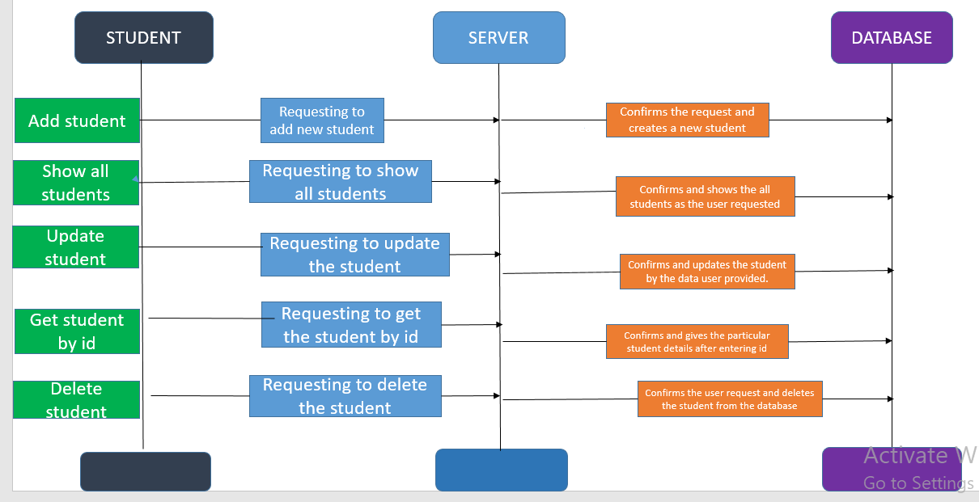
Sequence Diagram

Slide 13
Modules
Add
Add students
Show
Show All Students
Delete
Delete Student
Update
Update Student
Get
Get Student based on roll number
Exit
Exit Student

Slide 14
PROJECT OVERVIEW
The Student Management Application that helps schools keep track of student's information.
The goal of this application is to make it easier for schools to organize and access student information.
This application make management to communicate with students and parents via e-mail or SMS.

Slide 15
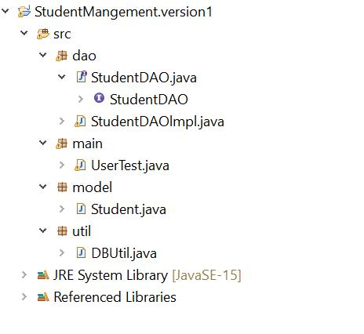
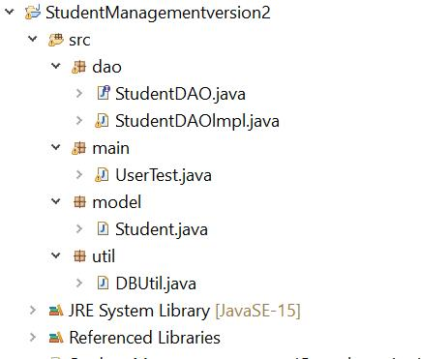
Source Code Project Structure

Slide 16
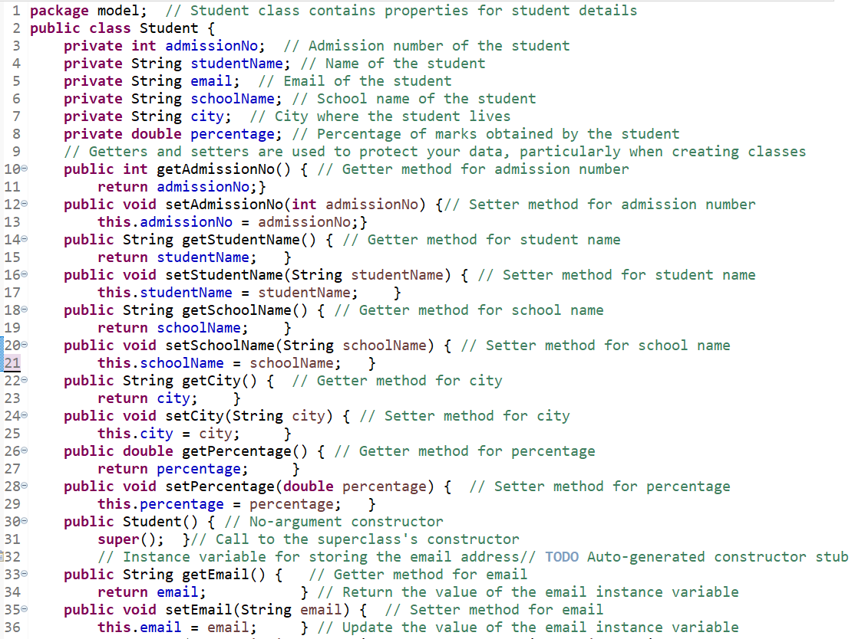
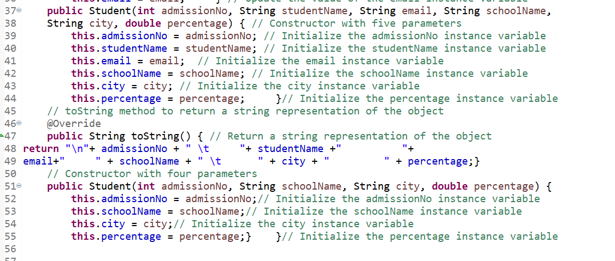
Model Class

Slide 17
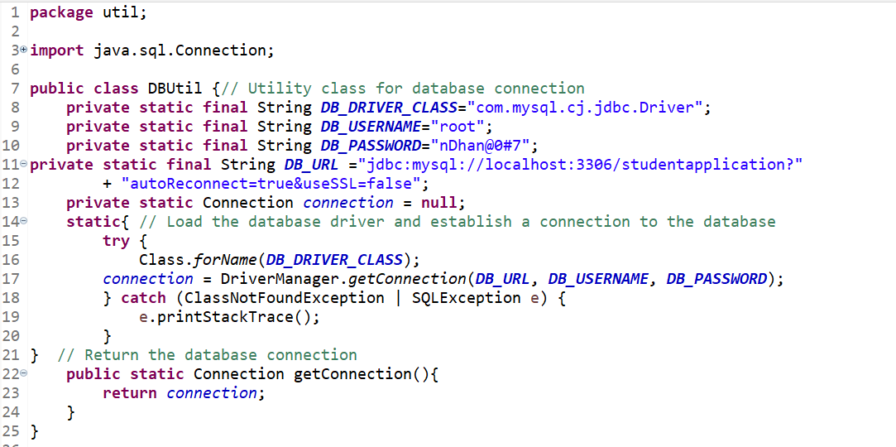
Database connection in DBUtil class

Slide 18
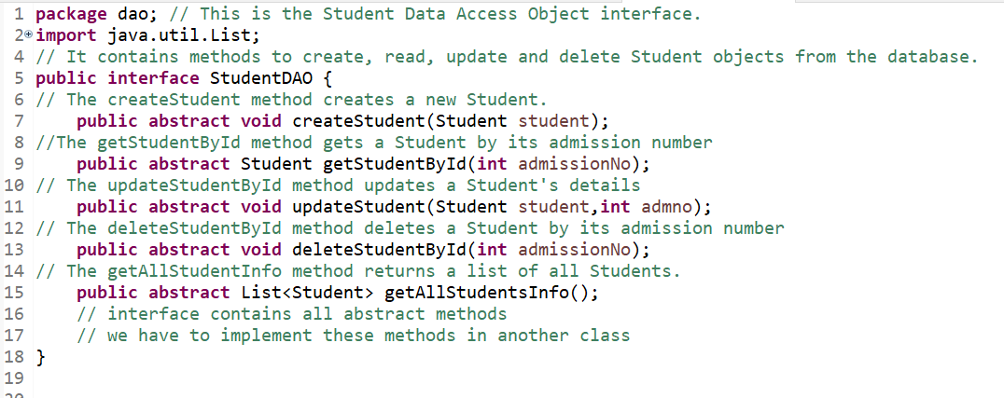
StudentDAO Interface

Slide 19
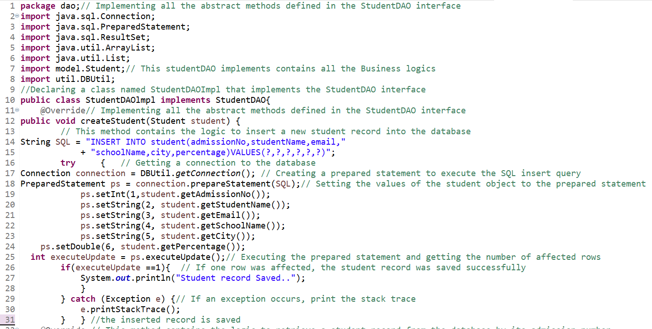
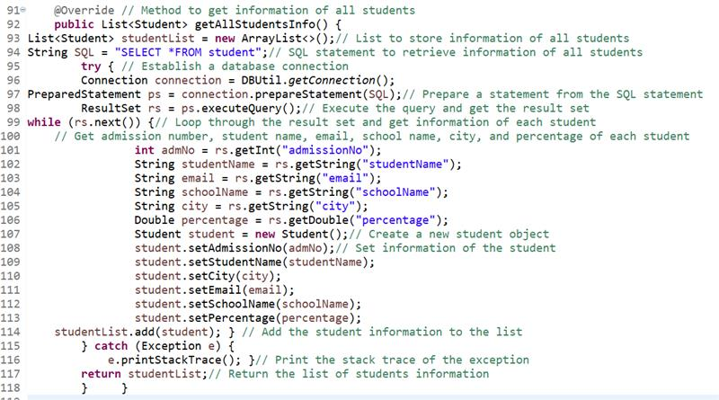
StudentDAO implements
.

Slide 20
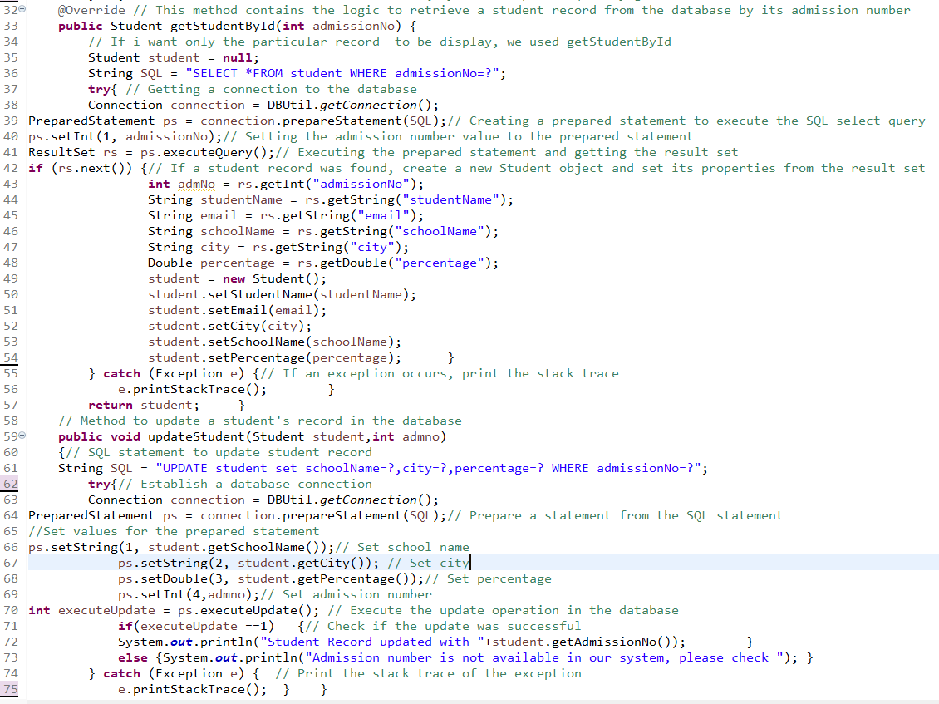
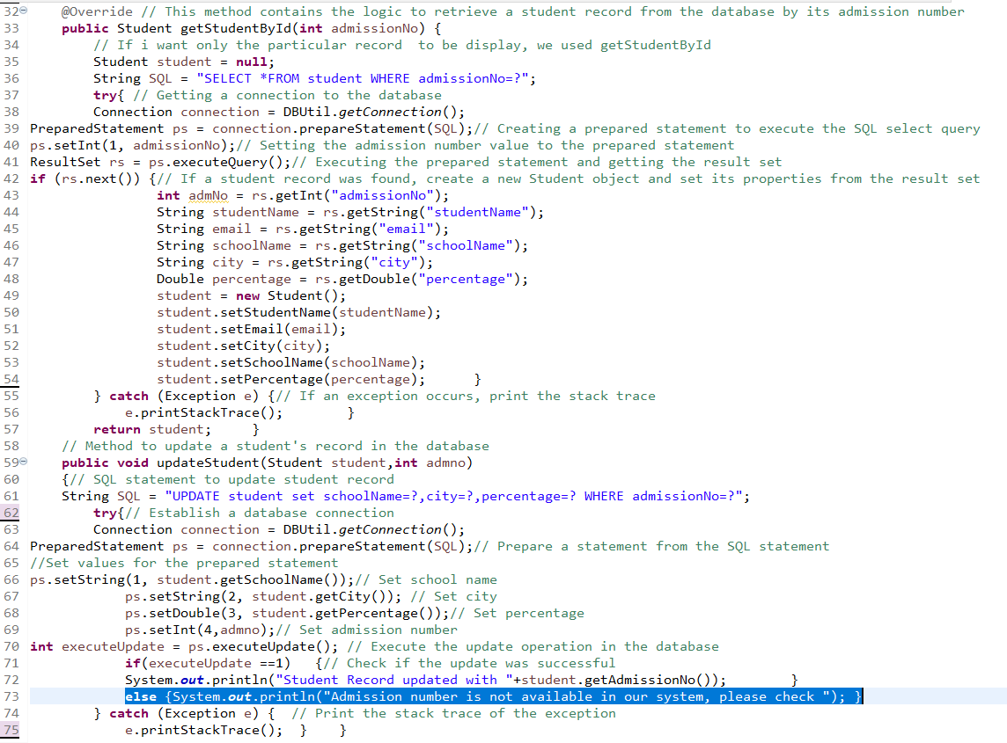
StudentDAO implements
Version 1
Version 2

Slide 21
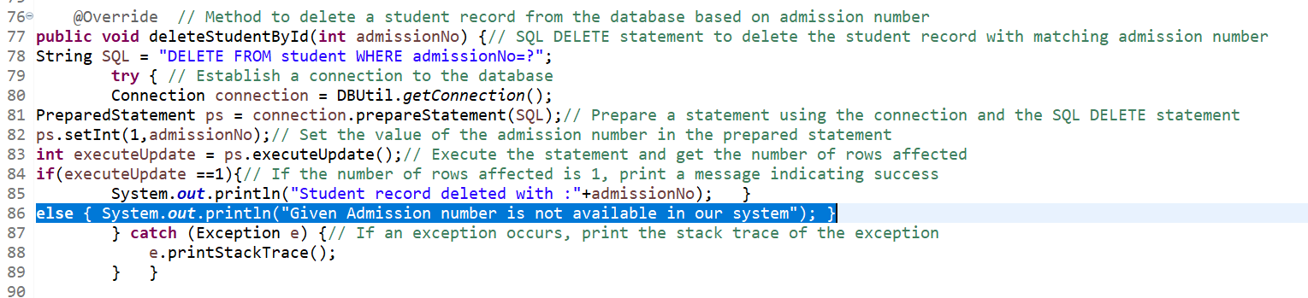
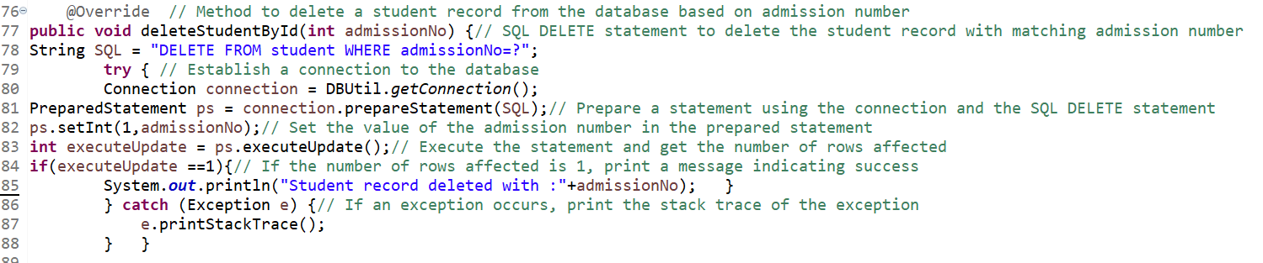
StudentDAO implements
Version 1
Version 2

Slide 22
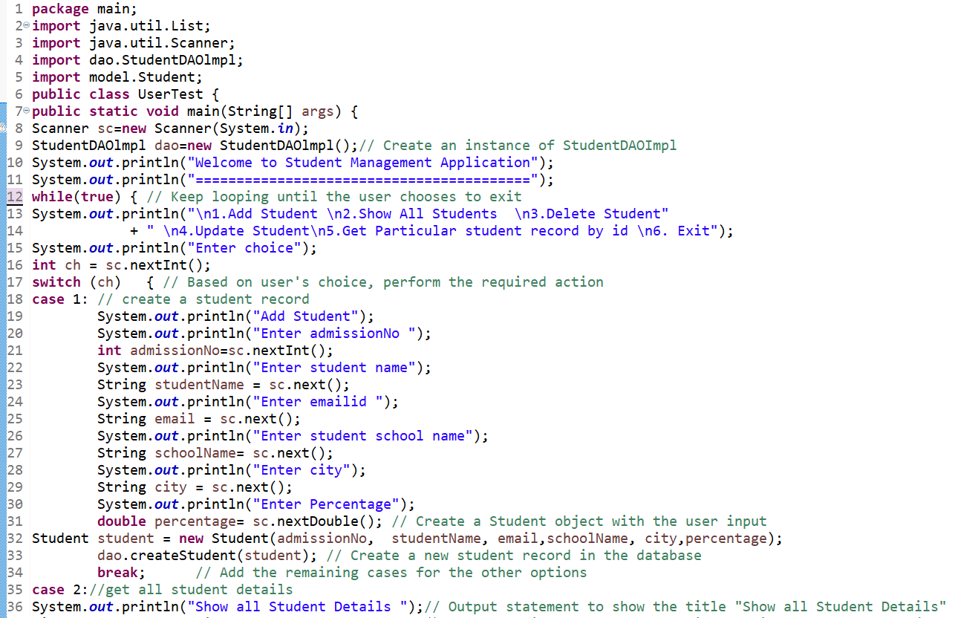
Main Class

Slide 23
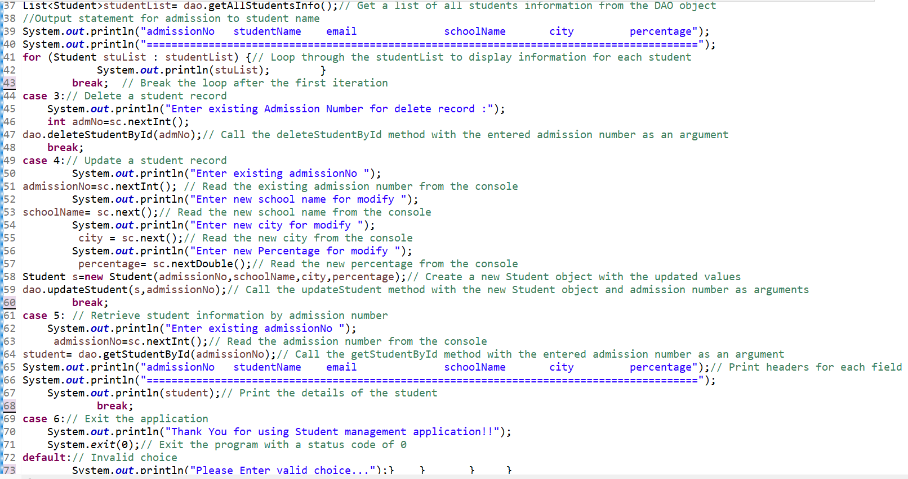
Main Class

Slide 24
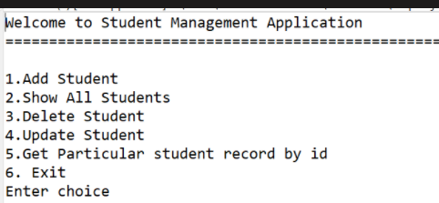
WELCOME MODULE
...

Slide 25
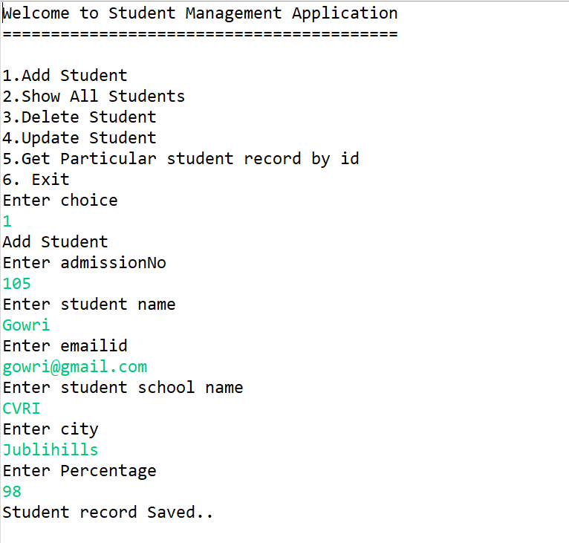
ADD STUDENTS
..

Slide 26
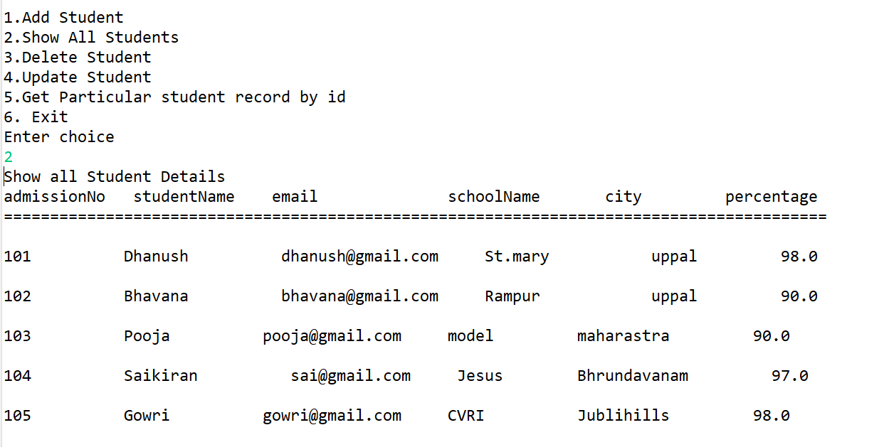
Show All Students
..

Slide 27
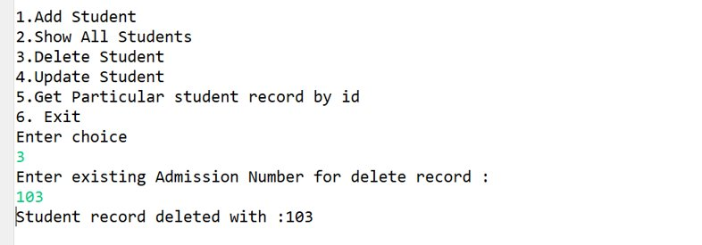
Delete Student

Slide 28
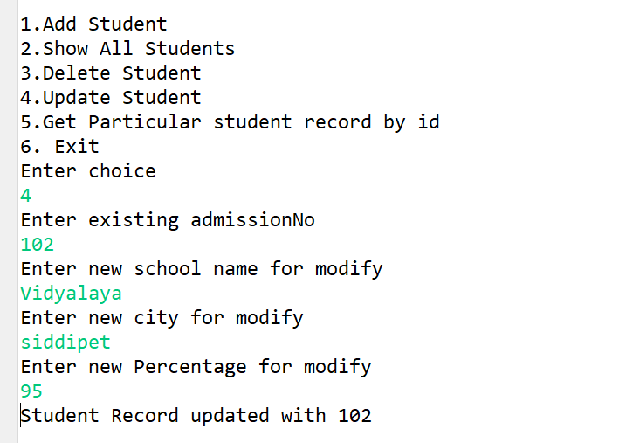
Update Student

Slide 29
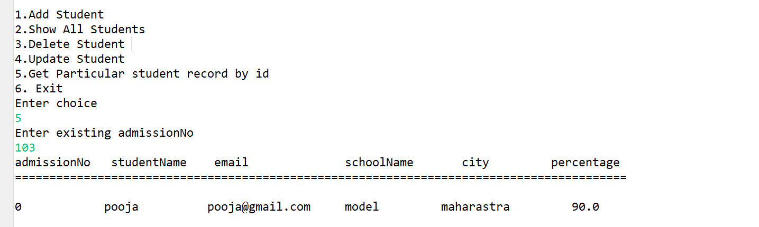
Get student based on admission no

Slide 30
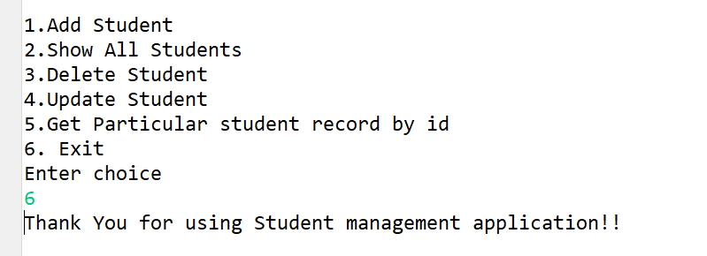
Exit

Slide 31
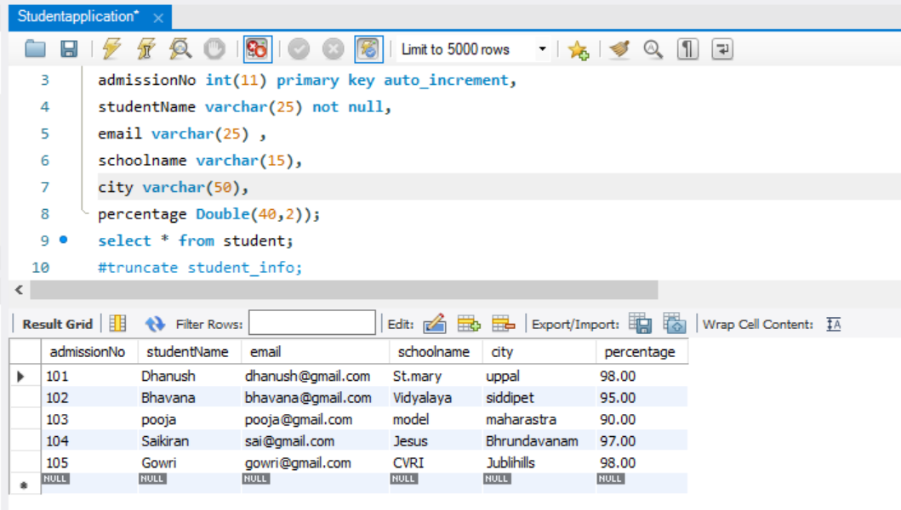
SQL DATABASE

Slide 32
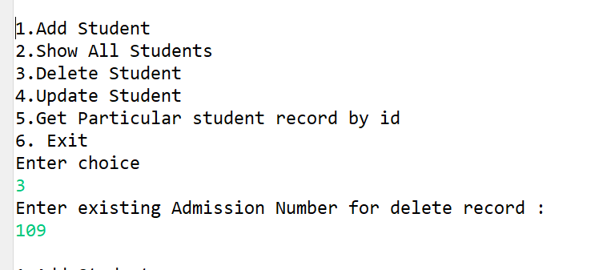
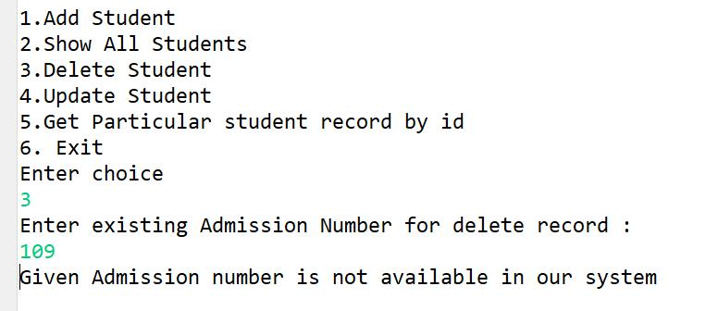
Defect in Delete Module.
Invalid
Valid

Slide 33
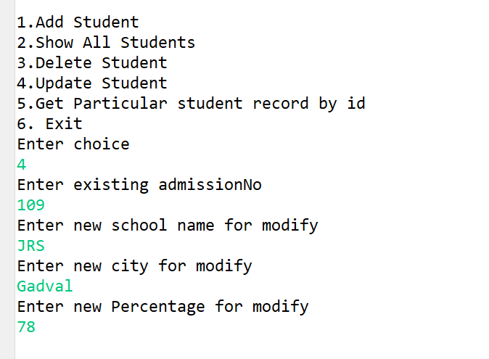
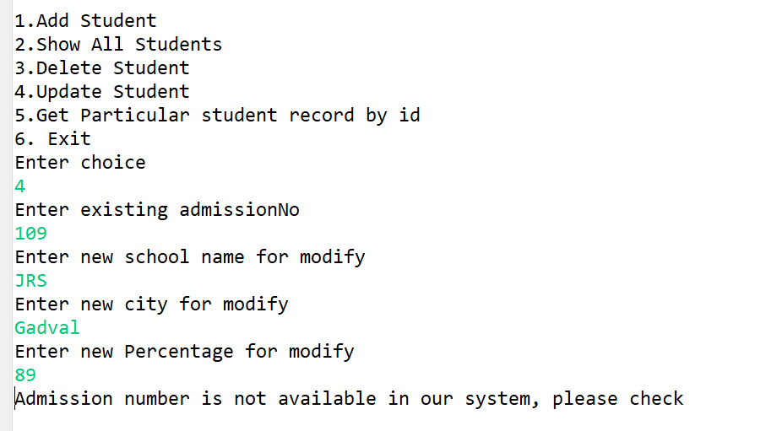
Defect In Update
Invalid
Valid

Slide 34
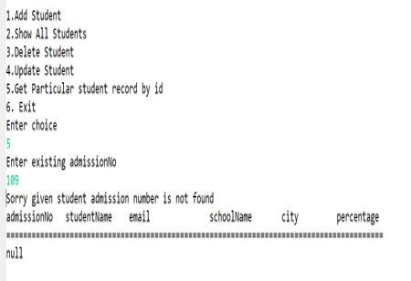
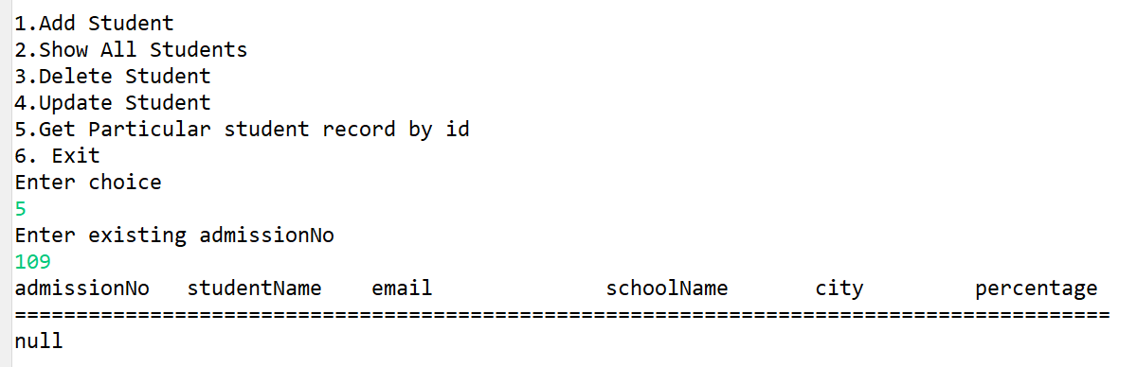
Defect in Get Student by ID
Invalid
Valid

Slide 35
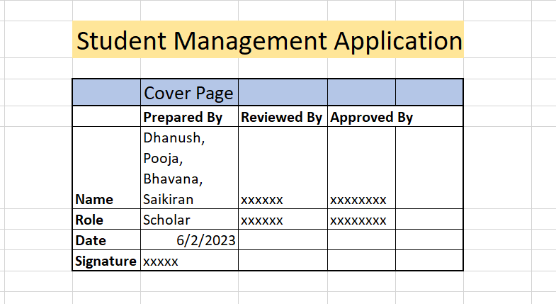
Cover Page

Slide 36
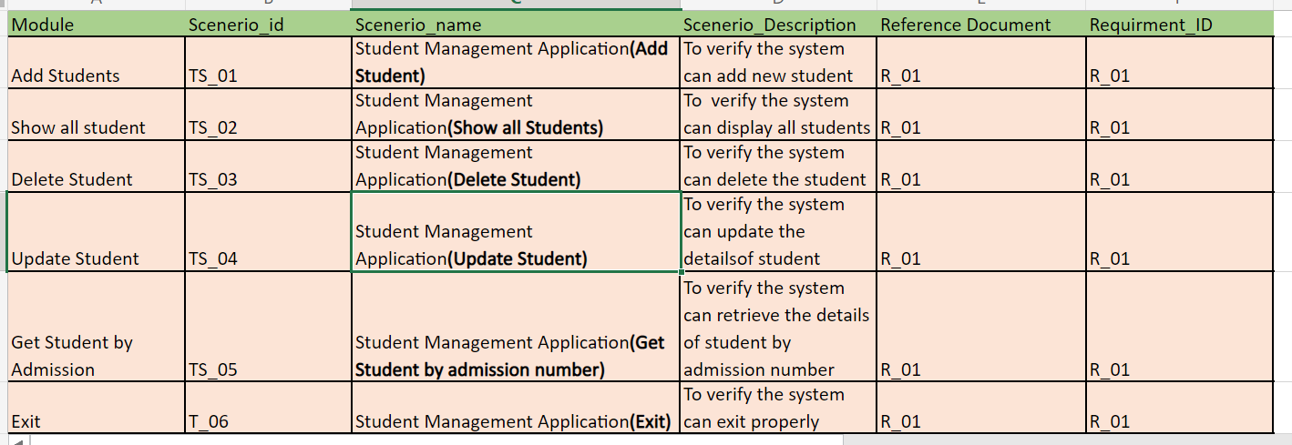
Test Scenarios

Slide 37
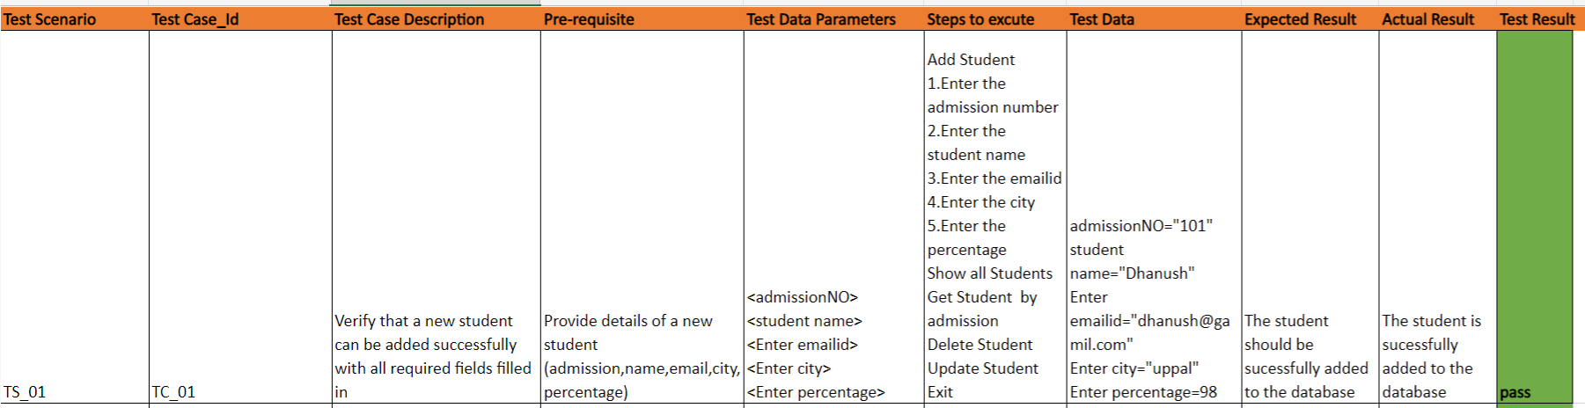
Test Case 1

Slide 38
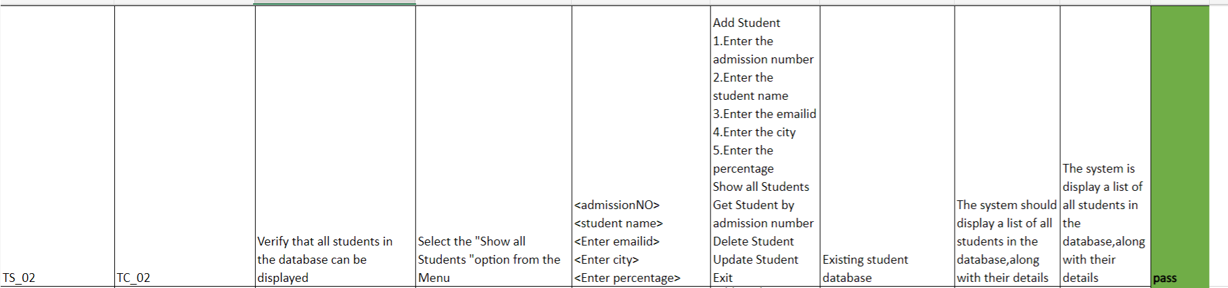
Test case 2

Slide 39
Test case 3

Slide 40
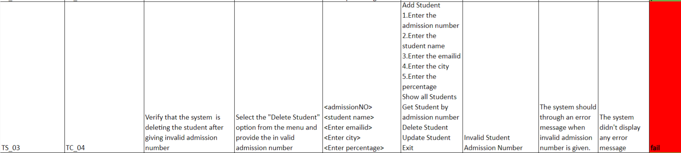
Test case 4

Slide 41
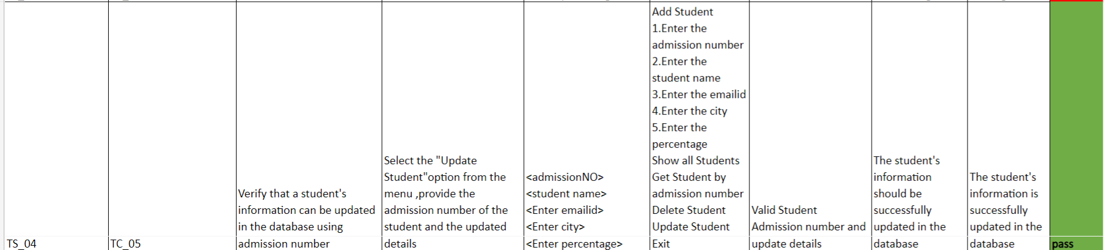
Test case 5

Slide 42
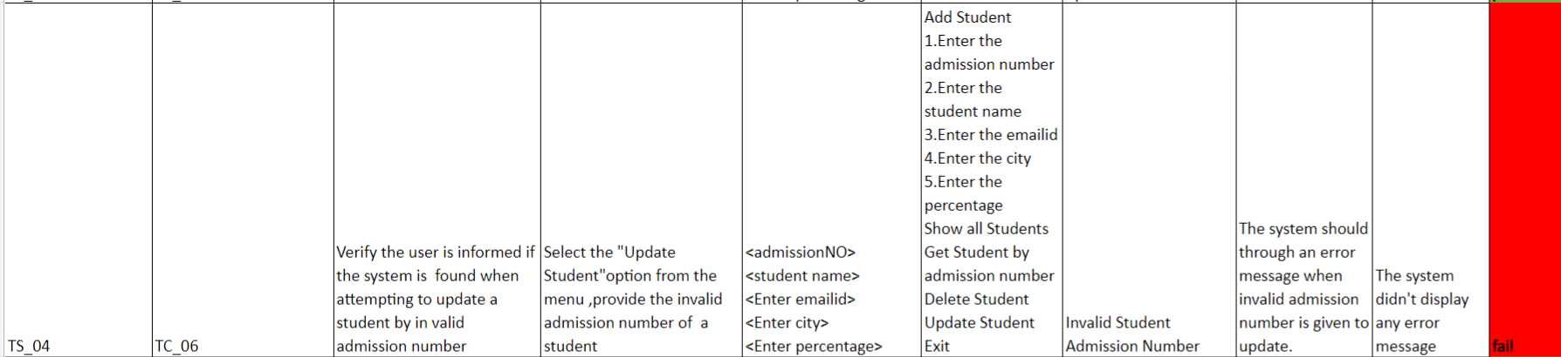
Test case 6

Slide 43
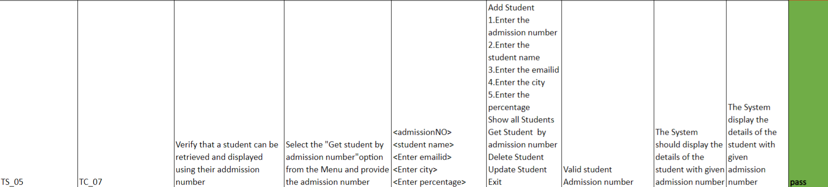
Test case 7

Slide 44
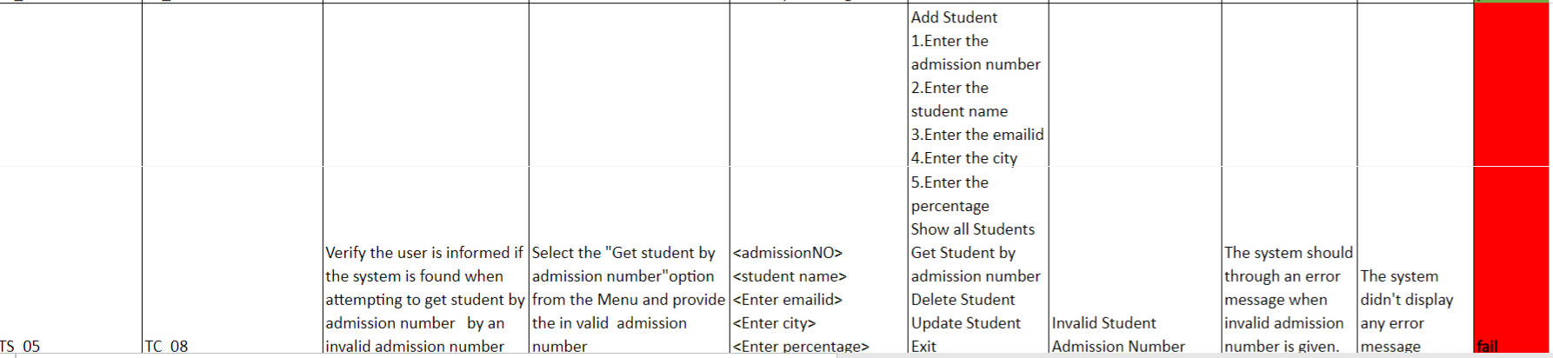
Test case 8

Slide 45

Test case 9

Slide 46

Defect Log

Slide 47

Defect Log

Slide 48

Defect Log

Slide 49

RTM

Slide 50

Automation
For Swag Labs
This Photo by Unknown author is licensed under CC BY-SA-NC.

Slide 51
Project Overview
We automate the demo website name is "SwagLabs"
https://www.saucedemo.com
We are tested the functionality by Creating the Page Objects and classes of the Signing in, Product catalog, Purchase and User is able to.
We have added Extent Report and TestNG emailable Report for each test case.

Slide 52


Defects
Username: standard_user
Username: problem_user

Slide 53


Slide 54


Slide 55

Swag Labs Demo - Automation
Structure of the Project

Slide 56

Source Code Page Object_01

Slide 57


Page object_02

Slide 58


Page object_03

Slide 59

Page object_03

Slide 60


Page Objects_04

Slide 61


Data Provider

Slide 62

Data Provider

Slide 63


Data Provider

Slide 64


Test Case_01

Slide 65

Signing module extent report

Slide 66


Test Case_02

Slide 67

Signing module extent report

Slide 68


Test Case_03

Slide 69

Signing module extent report

Slide 70


Test Case_04

Slide 71

Test Case_04

Slide 72

Product catalog module extent report

Slide 73


Test Case_05

Slide 74

Test Case_05

Slide 75

Product catalog module extent report

Slide 76


Test Case_06

Slide 77

Test Case_06

Slide 78

Product catalog module extent report

Slide 79


Test Case_07

Slide 80

Test Case_07

Slide 81

Product catalog module extent report

Slide 82


Test Case_08

Slide 83

Test Case_08

Slide 84

Purchase module extent report

Slide 85


Test Case_09

Slide 86

Test Case_09

Slide 87

Purchase module extent report

Slide 88


Test Case_10

Slide 89

Test Case_10

Slide 90

Purchase module extent report

Slide 91


Test Case_11

Slide 92

Test Case_11

Slide 93

Purchase module extent report

Slide 94


Test Case_12

Slide 95

Extent Report

Slide 96

Test Suite

Slide 97

TestNG emailable report

Slide 98
GitHub link:

Slide 99
Thank You

